Slide 1
Smart Travel App
Building a Smart Traveler Community

Slide 2
Business Objectives
To promote a variety of transport options, based on: shortest distance, fastest route, type of transport and disability friendliness
To ease the management of ticket with online ticket and e-wallet feature

Slide 3
Features
Public website and app introduction
Register to become a member
Find places, plan my travel, save travel to my favourite
Single e-ticket across different transport modes, including parking fee and toll fee
E-ticket amount top-up on the app
Transfer e-ticket amount to other user
For admin: Administrative functions, like users management, etc

Slide 4
Differentiator
What makes our app special? Here are few killer features which differentiate us with followers / others:
Integration with external transport providers
One single to manage my transport, which includes my travel history, ticket purchase, and booking
Single e-ticket
Recommendation engine

Slide 5
Tech Stack
Web FrontEnd: ReactJS
Mobile Web: ReactJS
API gateway: AWS API Gateway
Backend microservices: AWS Lambda
Database: AWS RDS
Files repository: AWS S3
User authentication: AWS Cognito
CDN: AWS CloudFront
Web application hosting: AWS S3
Logging: AWS CloudWatch
Recommendation engine: AWS SageMaker

Slide 6
Team Member
Rups: Sr. big data engineer / architect
Fernando: AWS full-stack developer / architect
Ian Goh: Python Django developer
Ishan: React, Java, Python developer
We are experienced in full-task AWS services, comprises of compute engine (EC2, beanstalk, Lambda), storage (S2), database (RDS, Aurora), API gateway, Machine learning and big data (Sagemaker), etc

Slide 7
Code Repository
Code repository: https://github.com/fernandokarnagi/smarttravel
Demo: http://smarttravel-app.com.s3-website-ap-southeast-1.amazonaws.com/

Slide 8
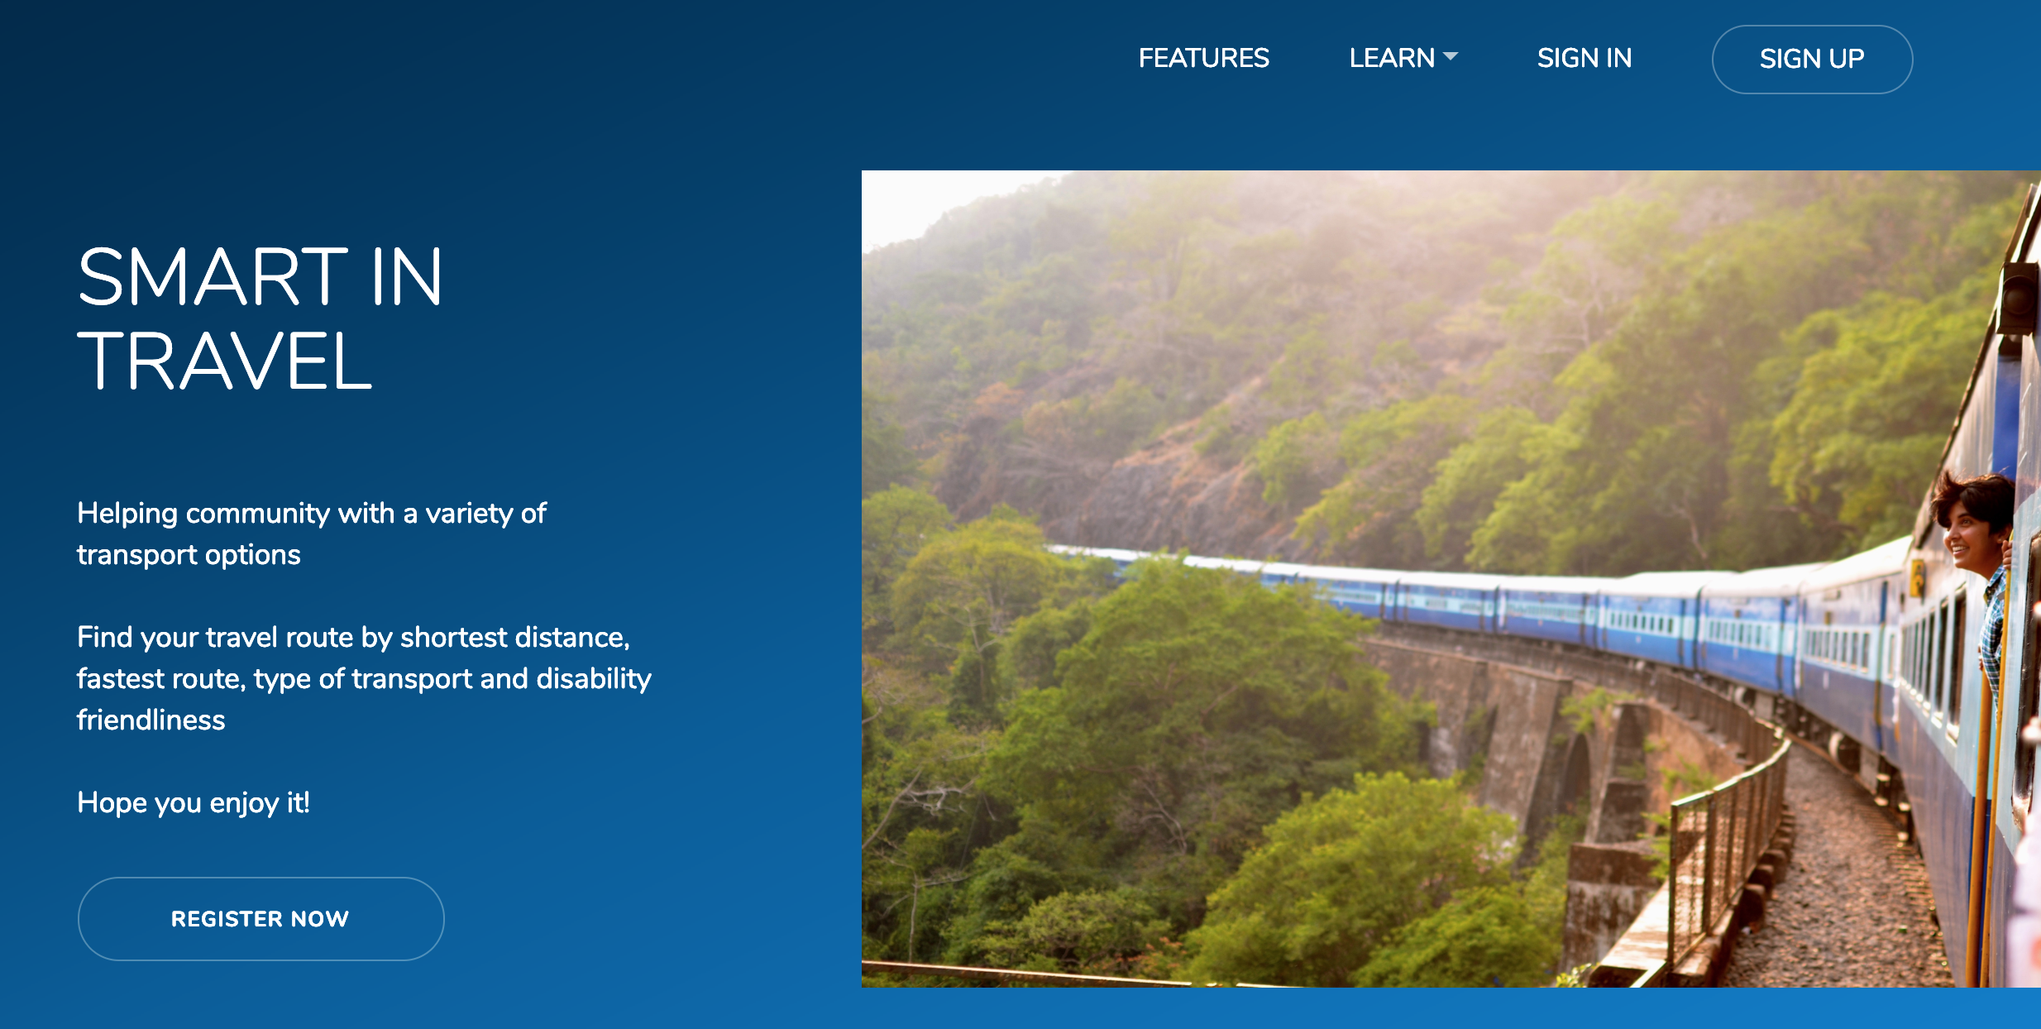
Public website

Slide 9
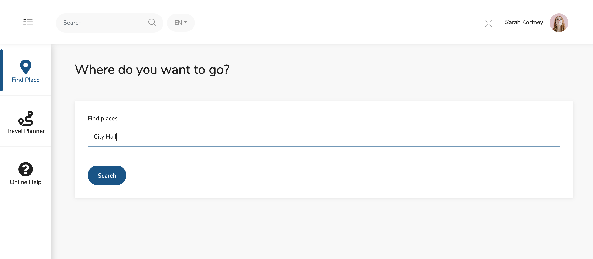
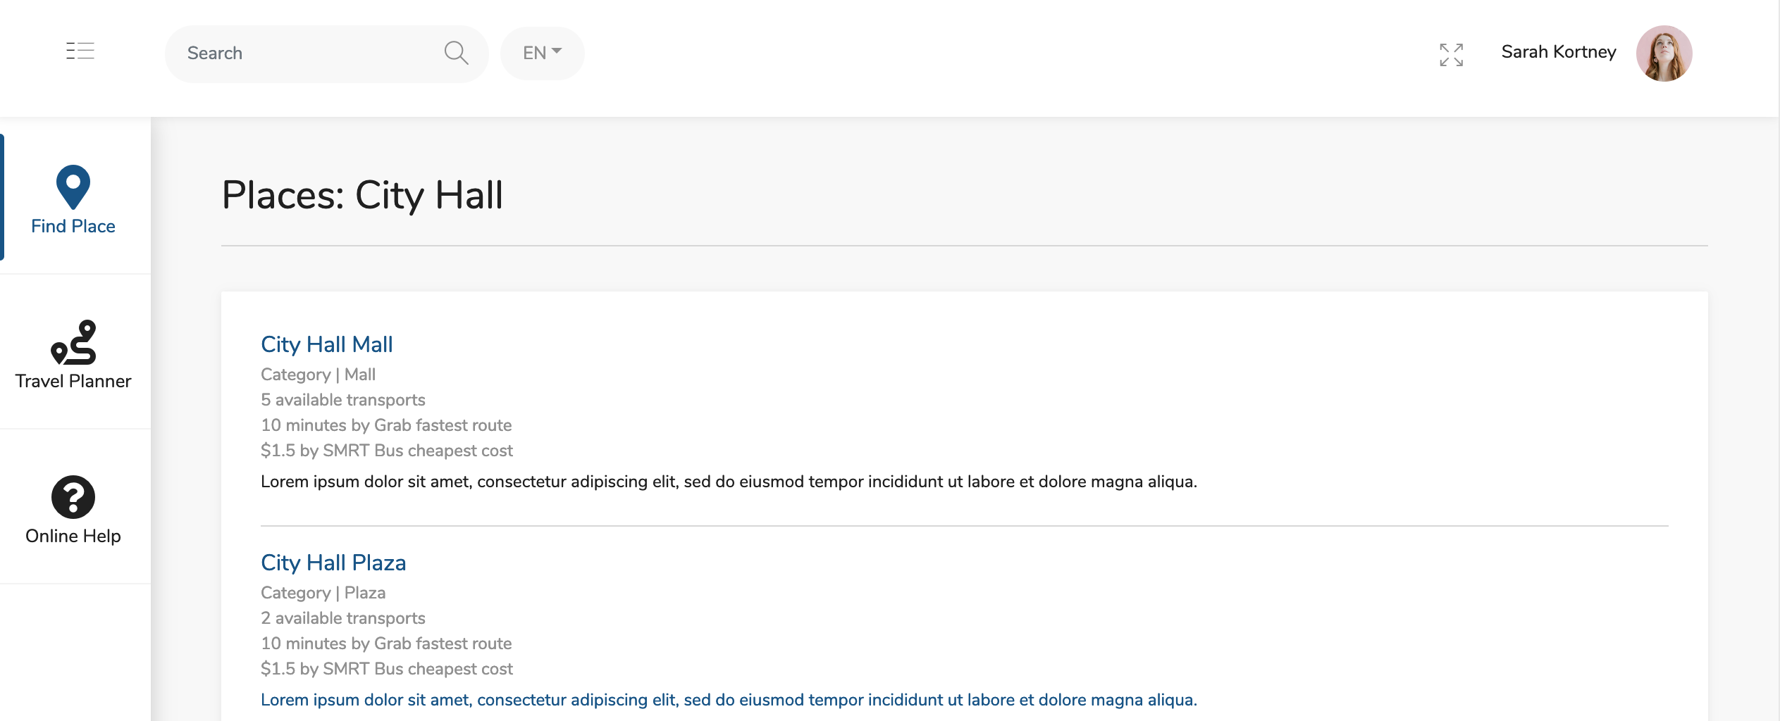
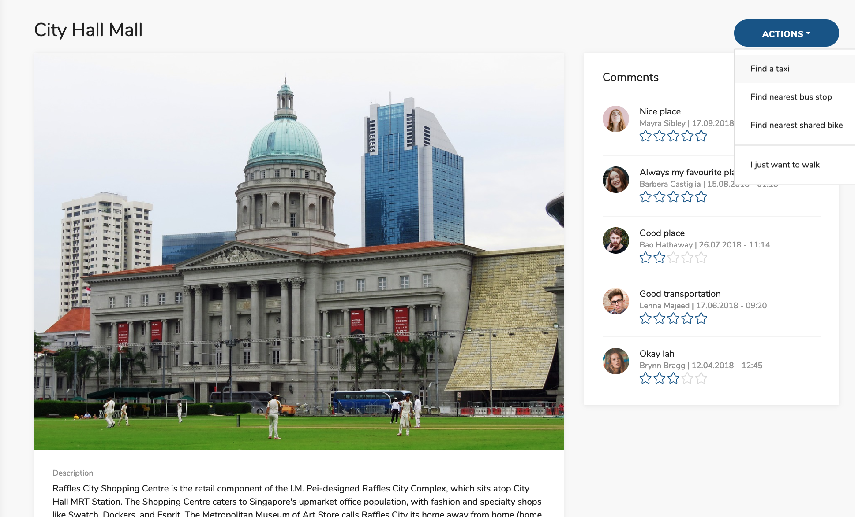
Easy Place Finder

Slide 10
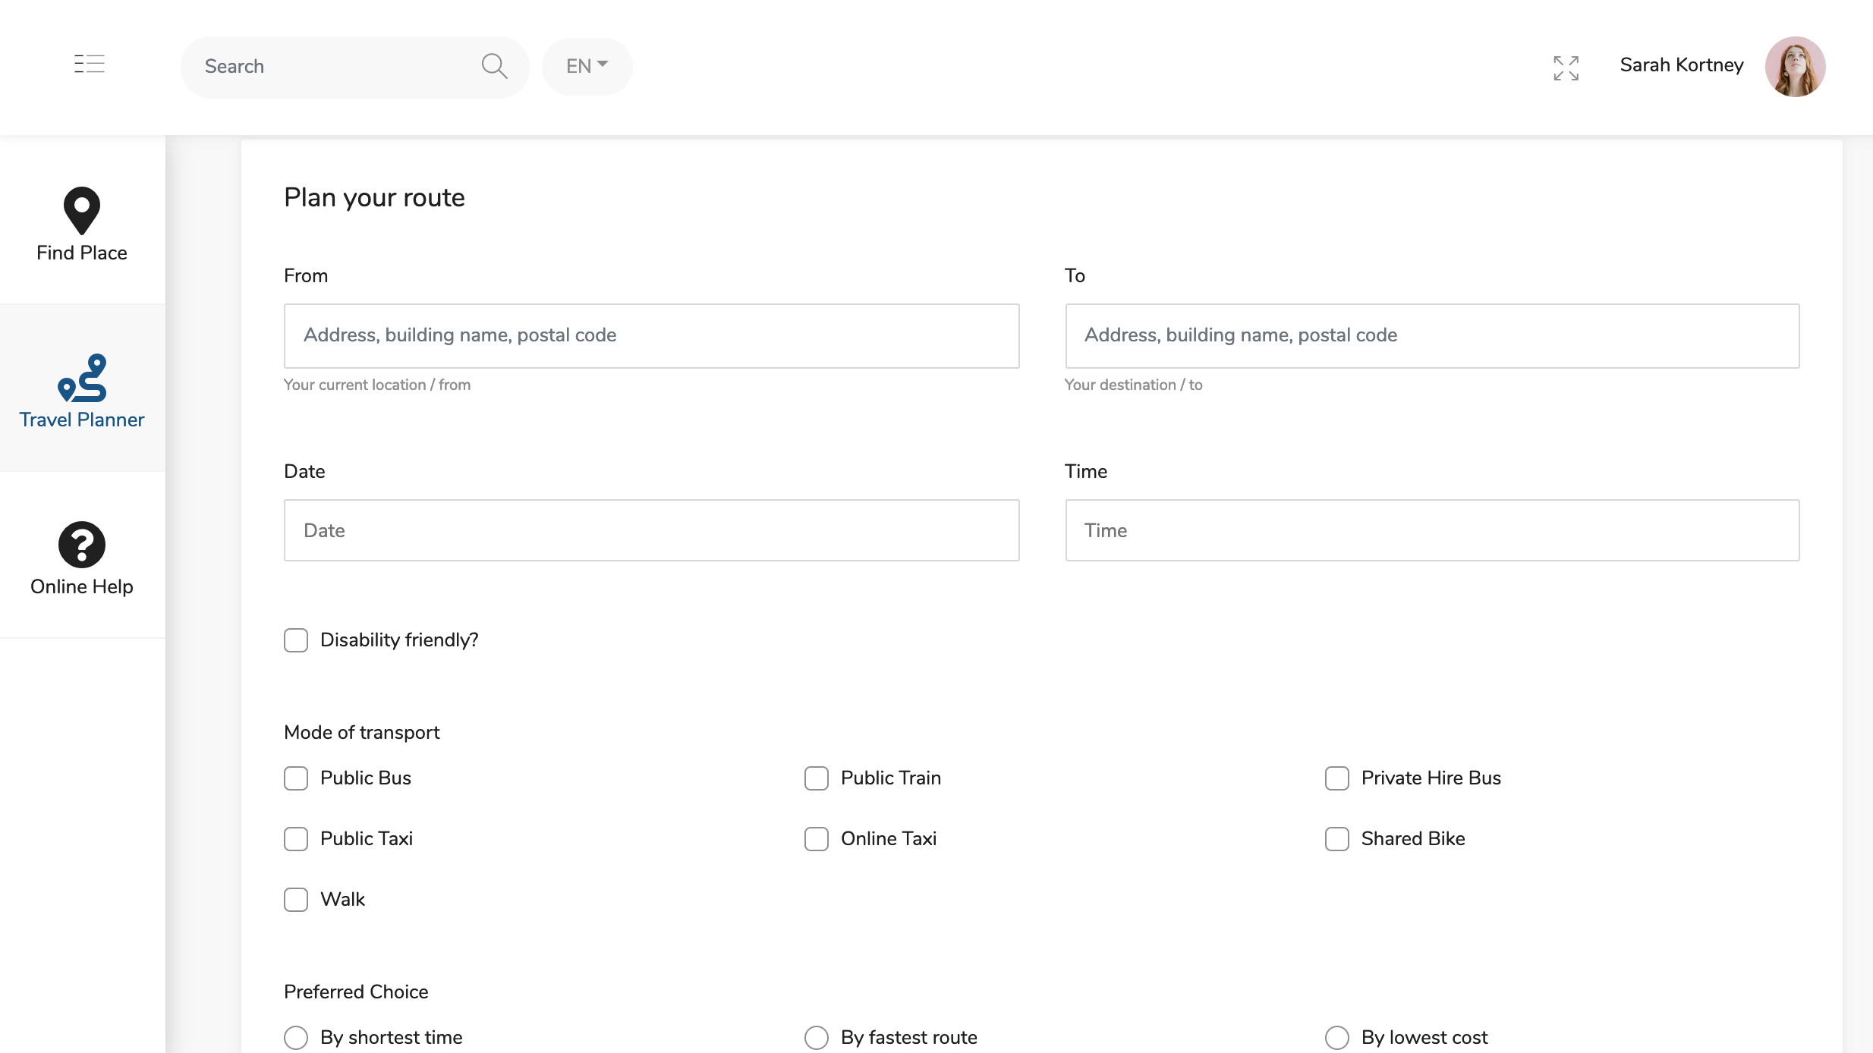
Plan your route

